Slide 1
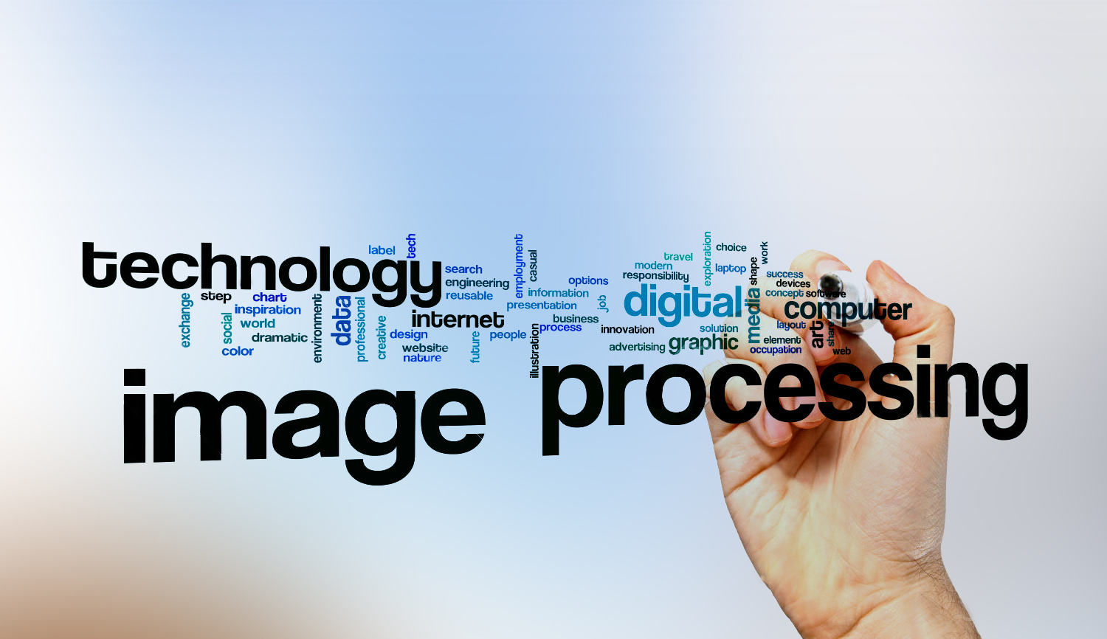
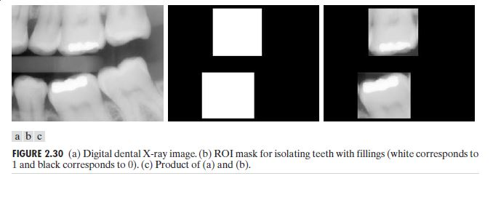
Digital Image Processing
10-Discuss how we can use image multiplication to extract Region of interest regions from a medical image.
Another common use of image multiplication is in masking, also called region of interest (ROI), which take Original then do a mask Finally (original x mask)

